Slide 1

NAME: SURYA SJ
NM ID: au412721205050
PROJECT TITTLE: Stock Market Prediction Using GAN

Slide 2
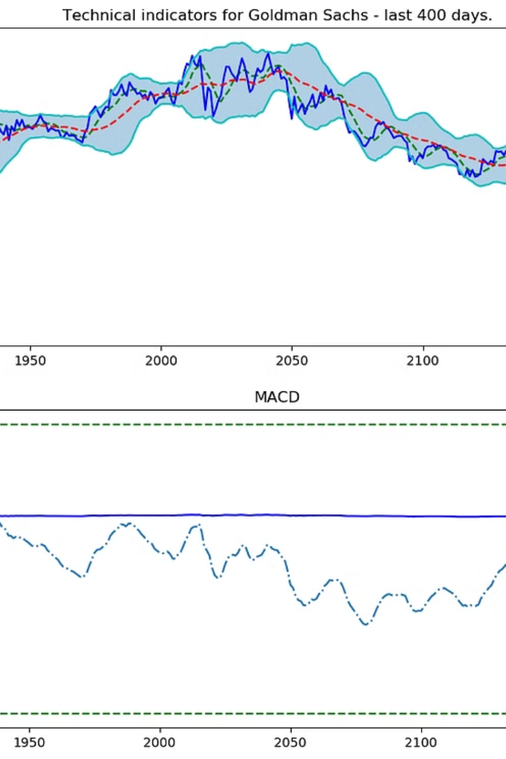
Stock Market Prediction Using GAN
The project on stock market prediction using Generative Adversarial Networks (GAN) aims to leverage advanced machine learning techniques to forecast market trends and make data-driven investment decisions. GAN, a powerful deep learning model, will be employed to analyze historical stock market data and generate predictive insights for future market behavior.
The project will provide an opportunity for undergraduate and graduate students in college to delve into the intersection of finance and artificial intelligence. Through this endeavor, students will gain hands-on experience in implementing cutting-edge technologies to solve real-world financial challenges, preparing them for the evolving landscape of quantitative finance and machine learning in industry.

Slide 3
Agenda
Introduction to GAN
Data Collection and Preprocessing
The agenda will start with an overview of Generative Adversarial Networks (GANs), explaining the concept, working, and its significance in stock market prediction.
This section will cover the crucial process of collecting and preprocessing the data required for training the GAN model for stock market prediction.
Model Architecture
End Users and Solution's Value Proposition
Explanation of the specific model architecture designed for stock market prediction using GAN, including details on the layers, activation functions, and optimization techniques.
An insight into the end users of the stock market prediction model, along with the value proposition it offers in the world of financial analysis and decision-making.

Slide 4
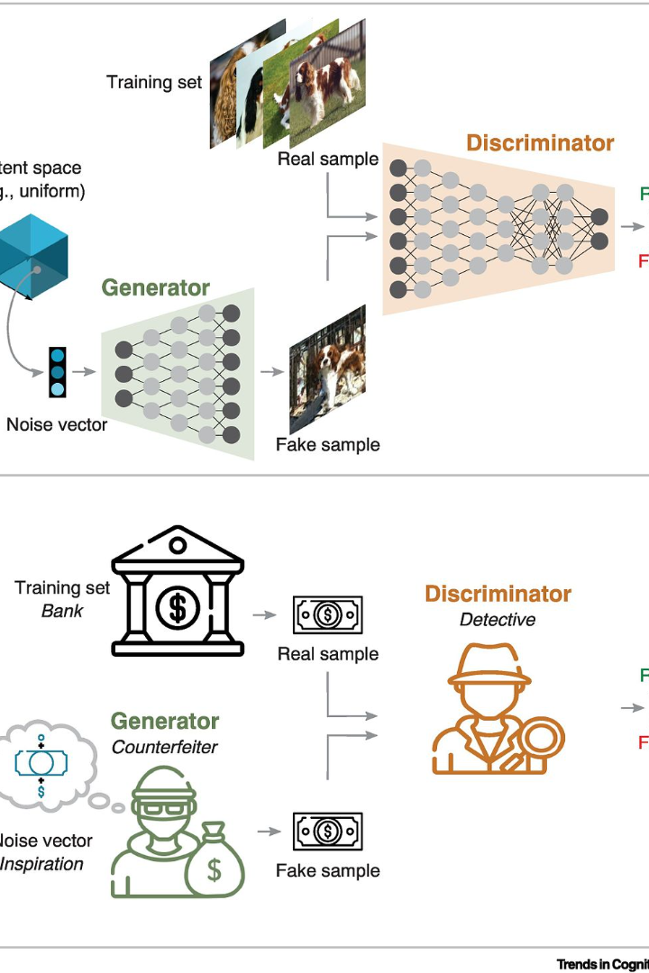
Understanding GAN (Generative Adversarial Network)
As we delve into the intricate world of Generative Adversarial Networks (GAN), it's essential to comprehend the fundamental workings of this powerful machine learning framework. GAN, introduced by Ian Goodfellow and his colleagues in 2014, consists of two neural networks, the generator, and the discriminator, engaged in a competitive and cooperative learning process. While the generator fabricates data, the discriminator evaluates it, with both networks striving to outsmart each other.
Through this symbiotic relationship, GAN empowers the creation of artificial data exhibiting remarkable similarity to real-world data, making it a revolutionary tool for modeling complex and realistic distributions. Its applications span various domains, including image synthesis, voice generation, and video manipulation, presenting a profound impact on the advancement of artificial intelligence.

Slide 5

Problem Statement
Stock Volatility: One of the key problems in stock market prediction is the high volatility of the market, making it challenging to accurately model future price movements.
Impact of External Factors: Factors external to the market, such as geopolitical events, economic indicators, and natural disasters, can significantly affect stock prices, adding complexity to prediction models.
Market Inefficiencies: Identifying and leveraging market inefficiencies for predictive insights is crucial but requires robust techniques to process and interpret data effectively.

Slide 6
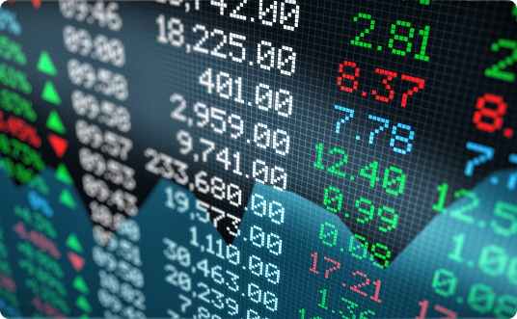
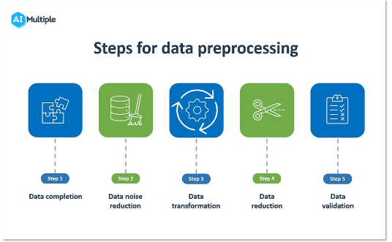
Data collection and preprocessing
Data Collection
Data Preprocessing
Before initiating the predictive process, a critical step involves data collection. This encompasses gathering historical stock market data, including stock prices, trading volumes, market indices, and other relevant financial indicators. The data collected must be expansive and comprehensive, covering various time intervals and market conditions to ensure the robustness of the predictive model.
Once the data is accumulated, preprocessing plays a pivotal role. This involves data cleaning, normalization, and feature engineering to transform the raw data into a suitable format for the GAN model. It includes handling missing values, outlier detection, and ensuring that the data is consistent and free from anomalies that could impact the prediction accuracy.

Slide 7
Model architecture for stock market prediction
Recurrent Neural Networks (RNNs)
Long Short-Term Memory (LSTM)
Convolutional Neural Networks (CNNs)
Generative Adversarial Networks (GANs)
RNNs are powerful in capturing sequential dependencies in time series data. They are capable of remembering past information and using it to make predictions. In stock market prediction, RNNs are used to analyze the time series data of stock prices and identify patterns that can help in forecasting future trends.
LSTMs are a type of RNN that is well-suited for making predictions based on time series data. They are designed to learn long-term dependencies, making them effective in capturing the complex and non-linear relationships present in stock market data. LSTM networks can retain information over long periods, making them suitable for analyzing and predicting stock market movements.
CNNs can be used to extract relevant features from stock market data. By applying convolution operations, CNNs can identify patterns and trends in the input data. In the context of stock market prediction, CNNs can be used to analyze historical data and extract key information that may be indicative of future market movements.
GANs are utilized for generating synthetic financial data that closely resembles the real market scenarios. By using GANs, the model can create artificial but realistic data points, which can be extremely valuable for training and validating the predictive models. GANs can also aid in generating diverse market scenarios, which can enhance the robustness of the predictive architecture.

Slide 8
WOW IN YOUR SOLUTION
Real-time Prediction
Interdisciplinary Learning
Our GAN-based solution provides real-time predictions, enabling students to make informed decisions based on the latest market trends and developments.
Engage in a multidisciplinary approach by learning about both stock market dynamics and cutting-edge artificial intelligence technologies through hands-on experience.
Practical Application
Ethical Considerations
Apply theoretical knowledge to practical scenarios, gaining valuable insights into the complexities of financial markets and the potential impact of AI-driven predictions.
Explore the ethical implications of using AI in financial decision-making, fostering critical thinking and responsible use of technology in the financial sector.

Slide 9



Who are the End Users?
Undergraduate Students
Finance Analysts
Graduate Students
Undergraduate students pursuing degrees in finance, economics, or related fields are potential end users of the stock market prediction using GAN. They can benefit from using the predictive model to gain insights into market trends, understand the impact of varying parameters on stock prices, and refine their understanding of financial markets.
Finance analysts seeking to enhance their predictive modeling capabilities and stay ahead of market trends can leverage GAN-based stock market prediction to refine their forecasting strategies. This technology empowers them to delve into advanced machine learning methods, providing valuable insights for making informed investment decisions and optimizing their analytical approaches.
Graduate students specializing in quantitative finance, data science, machine learning, or similar disciplines can also be the end users of the stock market prediction using GAN. The advanced predictive capabilities provided by the model can aid them in conducting research, developing trading strategies, and gaining practical experience in real-world market dynamics.

Slide 10

SOLUTION AND ITS VALUE PROPOSITION
When it comes to stock market prediction, the value proposition of using Generative Adversarial Networks (GANs) is significant. GANs have the capability to generate synthetic data that closely resembles the actual data. This is particularly valuable in the stock market context, where historical data and patterns play a crucial role. By leveraging GANs, our solution aims to provide accurate and reliable predictions for stock market movements, empowering investors to make informed decisions.
Furthermore, the GAN-based approach brings the potential for enhanced risk management, as it allows for the generation of diverse scenarios and what-if analyses. This can help investors and traders to better assess the potential outcomes and mitigate risks effectively. Additionally, the innovative use of GANs in stock market prediction sets our solution apart, offering a unique and cutting-edge methodology that is essential for the current and future landscape of financial technology.
With a focus on the needs of undergraduate and graduate students in college, our solution's value proposition extends to providing a deep understanding of advanced machine learning techniques applied to real-world financial datasets. This not only empowers students with practical knowledge but also prepares them for the evolving demands of the industry, equipping them with skills that are highly sought after in the job market.
This comprehensive and forward-thinking approach positions our solution as a leader in the field of stock market prediction, offering both practical utility and educational value to the next generation of financial professionals.

Slide 11
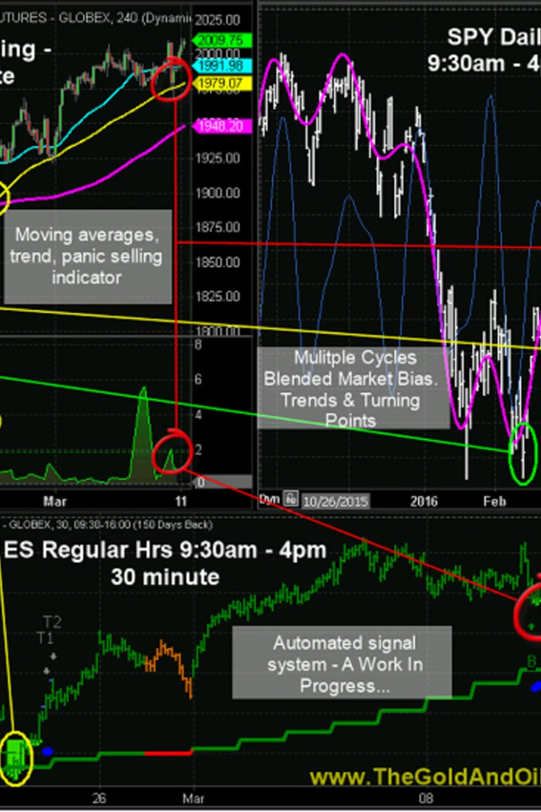
Conclusion
After a comprehensive exploration of the Stock market prediction using GAN, it's clear that this project holds immense potential in leveraging the capabilities of Generative Adversarial Networks to anticipate market trends. The utilization of GANs in forecasting stock market behavior has presented novel avenues for analytical insights and predictive accuracy. Throughout the journey, we've delved into the intricacies of GANs, data collection, preprocessing, model architecture, and the value proposition of our solution. By harnessing the power of GANs, we're poised to revolutionize the landscape of stock market forecasting.
With a focus on providing an in-depth understanding of the project, this presentation aimed to cater to both undergraduate and graduate students. The envisaged end users will derive immense benefit from the profound technical and analytical aspects covered in this endeavor. As we embrace the future of stock market prediction through GANs, this project stands as a testament to innovation, analytical prowess, and the pursuit of excellence.

